Slide 1



Big O Notation

Slide 2
Please make sure that you are always on mute unless you are called on.
Please make sure to be respectful in the chat!
If you send us a direct message, please give us some time to respond!
Please save all of your questions until the end, we will answer them in the Q&A section at the end of the session!
Try your best! It’s okay if you don’t get it right off the bat, these are very complex topics.
Get the Most out of this session

Slide 3
Big O Notation

Slide 4
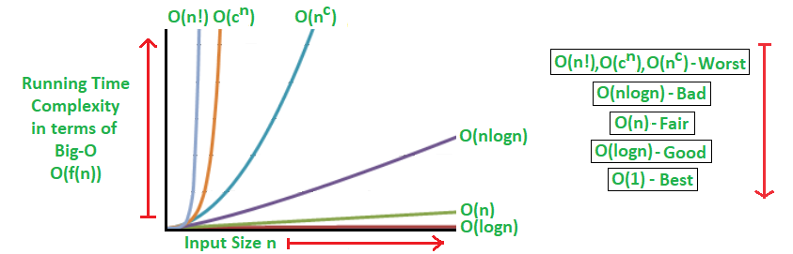
What is Big O Notation?
Big O Notation is a mathematical notation that figures out how the runtime scales based off of an input variable.

Slide 5
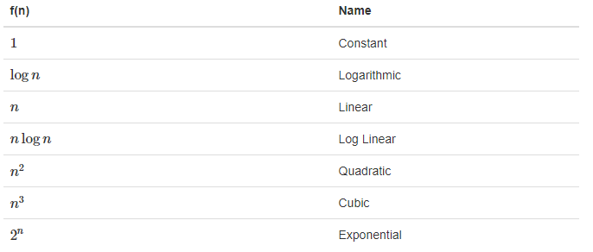
How do we measure Big O?
** We use big-O notation for asymptotic upper bounds, since it bounds the growth of the running time from above for large enough input sizes.

Slide 6
Rules of Big O Notation
Figure out what the input is and what n represents.
Express the maximum number of operations, the algorithm performs in terms of n.
Remove all the constant factors.

Slide 7
Properties of O(1)
Constant time will always take the same amount of time to be executed regardless of the input size.
Doesn’t have nested For Loops.
Consists of One Instruction.
EX: Accessing one thing in an array.

Slide 8
Properties of O(n)
Time to execute must be directly proportional to what’s being inputed.
the time it will take to run the algorithm will increase proportionately as the size of input n increases.
Properties of O(n)
O(n²) represents an algorithm whose performance is directly proportional to the square of the size of the input data set.
Deeper nested iterations will result in O(n³), O(n⁴) etc.

Slide 9
Write a Time Function in Constant, Linear and Quadratic Time - Activity #1
Write an algorithm that runs in constant time.
Follow the rules and properties that were previously listed.
Examples of algorithms:
Accessing Array Index (int a = ARR[5];)
Inserting a node in Linked List
Linear Search
Deletion of a specific element in a Linked List (Not sorted)
Comparing two strings
Bubble Sort

Slide 10
Optimizing Your Code With Big O Notation
Ask Questions & Psuedo Code
Write out code that matches your strategic plan
Figure out what it’s run time is.
See if you can optimize it. Code that is written in Linear Time is the best case scinerio.
Sometimes you wont be able to optimize more that what is already written and that’s okay.

Slide 11
Activity #2: Optimizing Your Code With Big O Notation

Slide 12
Lets Practice

Slide 13


